Slide 1
Grocery Buddy
By Ecoders (Group 25)
Patrick, Raly, Kevin, Toni, and Carlo

Slide 2
Problem
The majority of food waste occurs due to busy lifestyles and forgetfulness
Notes:
People want to be food waste conscious; however, the majority of food waste occurs due to busy lifestyles and forgetfulness

Slide 3

Solution
Create grocery lists
Track the shelf life of your food
Notes:
We created Grocery Buddy as a convenient and engaging solution to this problem
It is an assistant that helps you create grocery lists and
Track the shelf life of your food
Through this, we hope that users can make the most of what they have so their food doesn’t go to waste

Slide 4





Our Technology
Notes:
In building our app we used a lot of different technologies

Slide 5
Angular 2
JavaScript Framework
Single page applications
Highly Modular
AngularFire2 Integration
Notes:
Angular 2 is a JavaScript framework for building single page applications
It’s highly modular which allows for smaller file sizes
Supports Firebase through AngularFire2 library
It was hard to learn, but as a result, we were able to create a superior product

Slide 6
Project Management

Slide 7
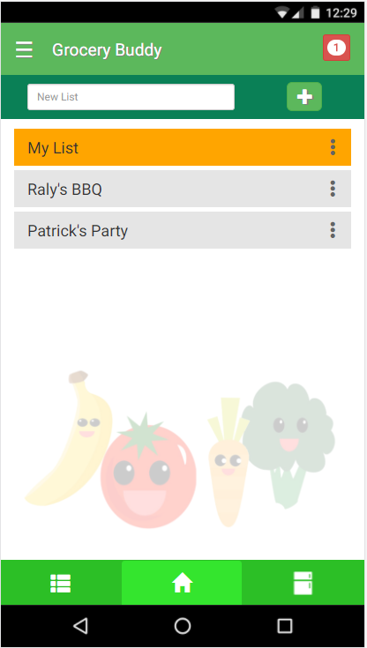
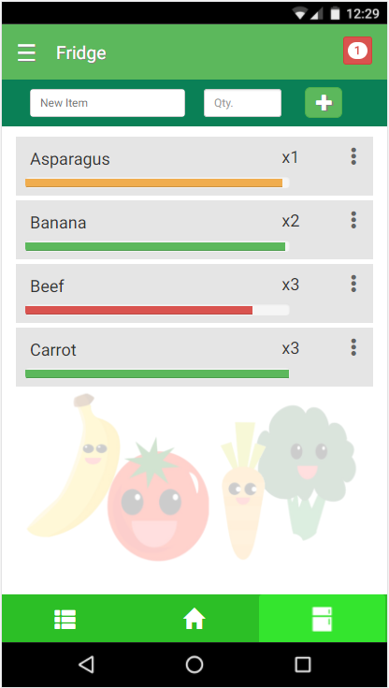
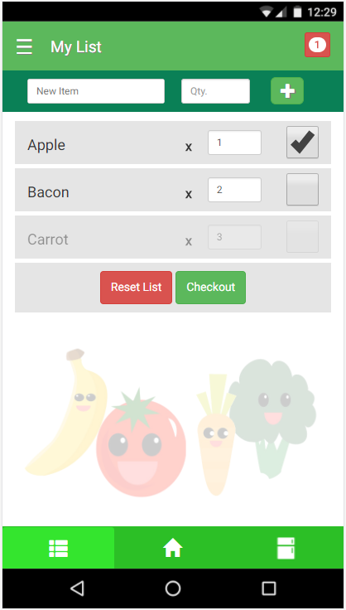
Highlights
UX planning
Time for learning
Specialization
Notes:
We spent a lot of time on our UX early on contributing to a strong sense of design and vision
We allocated time to learn new technologies to establish a strong foundation
We specialized our tasks and responsibilities to produce higher quality content more efficiently

Slide 8
Demo

